Slide 1

Mukerji Lab Internship Presentation 2020
Notes:
Notes

Slide 2
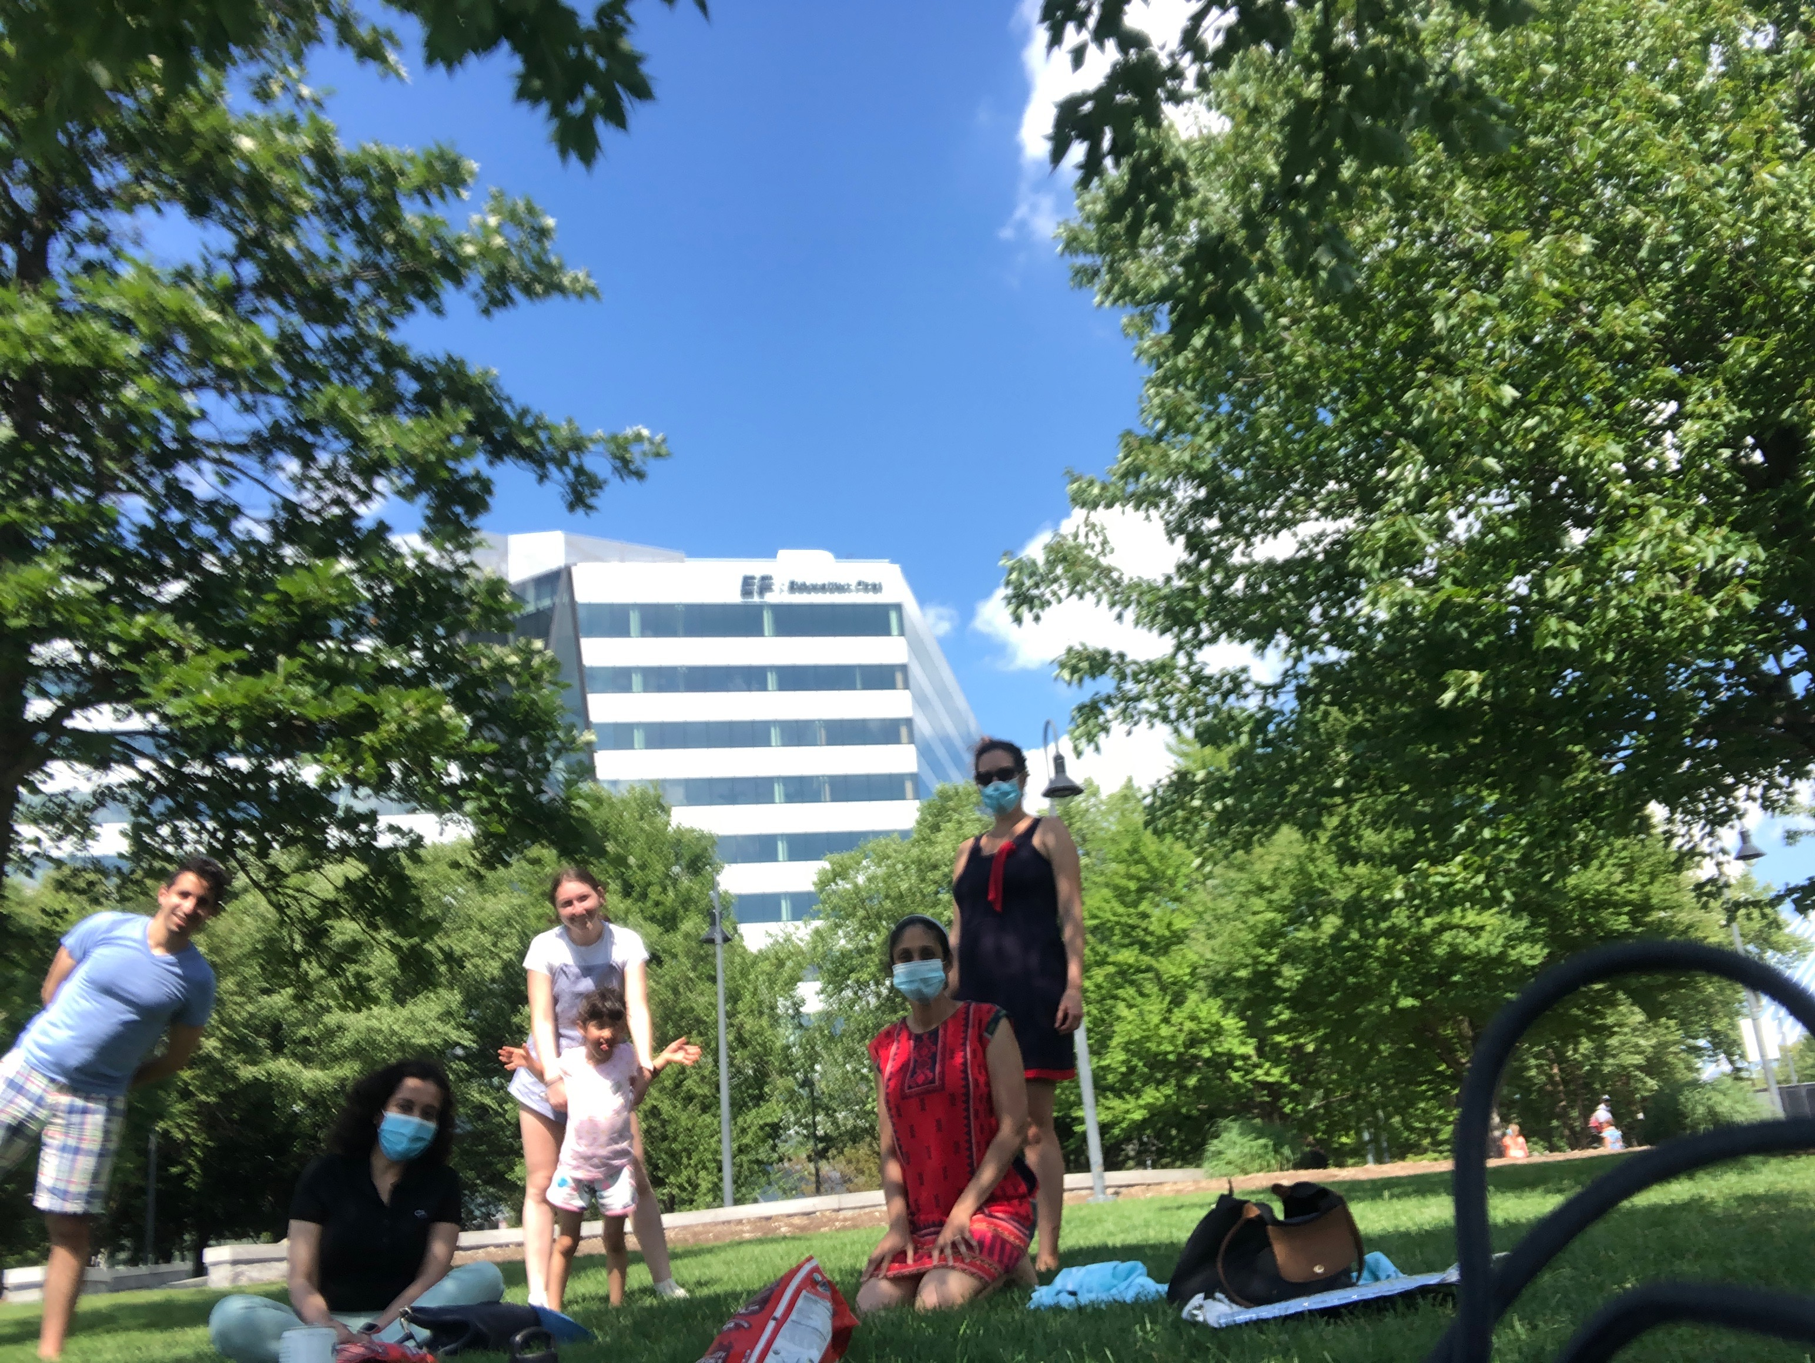
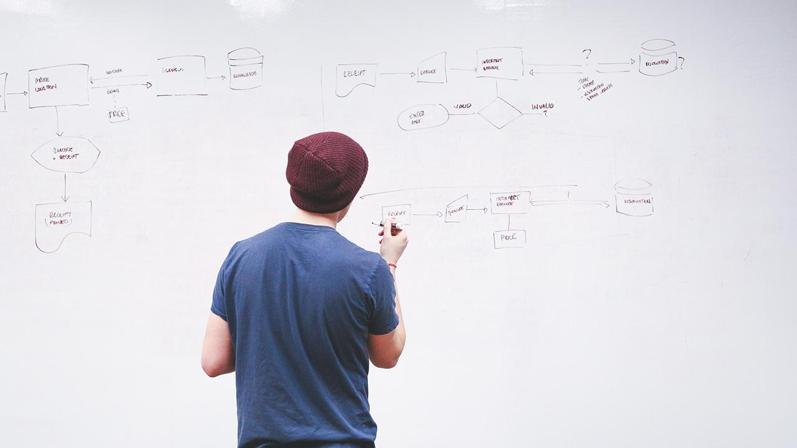
Introductions
Amy Ly
Sarah Reyes
Aliyah Rodriguez
Dr. Shibani Mukerji’s Lab
Neuro-infectious disease
COVID-19
Notes:
Amy Ly – Tufts University – Cognitive Brain Sciences – Computer Science
The other introductions
Dr. Shibani Mukerji – what her lab focuses on – thought it was really cool!

Slide 3
KEY GOALS
More on COVID-19
Learn more about neuroinfectious diseases
Practice working with larger datasets
Learning R
Notes:
So, the big thing that’s affecting everyone right now is the pandemic. ALL of it → Limited interaction with the news.
Neuroinfectious diseases → reading other articles that the lab has published, etc

Slide 4
GOALS (cont)
Validations
Understand how research labs functions
Learn how to work with data
The importance of accurate research
Notes:
TODO: have them complete this slide

Slide 5
Formulating a question
What do I want to focus on?

Slide 6
Possible COVID-19 Questions
Social behavior
How closely are people following their cities restrictions?
What factors might have an impact on their behavior?
How have people’s behaviors changed over the course of quarantine?
Measurable data
Positive counts + death counts
age ranges?
race?
township?
Frequencies over the course of quarantine?
Effect of immigrant status?
Notes:
As we follow the news …. Inconsistent …
I wonder about the rates of people tested and the differing factors that might affect that → news → household education
Anything that can affect you and your identity → SES, county, age, ethnicity, race, etc
Quarentine has felt sooooo long. How have people’s behaviors changed over time?
Translated into measureable data → age, race, township, all over the course of time

Slide 7
Factors to focus on
Immigrant
Status
Time
Age
Race
Ethnicity

Slide 8
Working with the data
Learning R and using large datasets

Slide 9
Data wrangling: preparing the data to be analyzed
As a data scientist, 90% of your time will be spent wrangling the data
- Dr. Shibani Mukerji
Notes:
Lol this as a quote --- my mentor haha
Wrangling as a word → wrestling and untangling
Data wrangling: the process of transforming and mapping data from one “raw” data into another format with the intent of making it more valuable for a variety of downstream purposes such as analytics
Working with larger data sets → any problems in formatting, inconsistencies (population, positive counts)
Problems scale upwards with the size of the dataset

Slide 10
Learning how to use R
R – free programing language used for statistical computing
Independence
Gathering resources
Learning syntax and debugging online
Logical thinking
Notes:
Previous experience in computer science → C++
All languages are similar in their structure – similar to human languages – the distinct units – words – types of words – grammar – how we string the words together
Translate and apply my C++ knowledge into learning R
Fully independent in learning → applying my knowledge and working through the bugs!!! Learning how to search up errors and how to search up what I want to do. – labels on bar graphs or grouping and counting items in a specific group
- Learning how to google is a skill in itself – my own parents

Slide 11
Available datasets – Pros and Cons
DPH data
MGH pipeline
US Census Data
US Postal Service Zipcodes
Our world in data
Covid Act Now
Proximity One
Accuracy
Recency
Relevancy
Formatting
Notes:
Who conducted the gathering of the information? Credibility
MGH data → must validate
How closely does it tie into my research questions?

Slide 12
Importance of Accuracy
Gathering P. acnes articles for accurate information
Inputting data for HIV study
Responsible for participant's information
Accurate Data= Accurate results
Avoids misunderstands
Notes:
TODO: What have they done!!
+ add in more slides if necessary
Verification
Validation
Looking for articles
Redcap data

Slide 13
The Analysis
What’s the story?
1. Immigrant status across age groups
2. Filling in the missing data
3. Racial/Ethnic disparities
Notes:
So I had different goals in mind, but the story I’m going to present is the one that looks the most linear and logically done, from one graph to the next
There were other factors that I had explored – see the squiggle path – but I thought this data made the most sense to present
Overview:
Immigrant status across age groups
Problem of filling in the missing data
Racial/Ethnic disparities

Slide 14
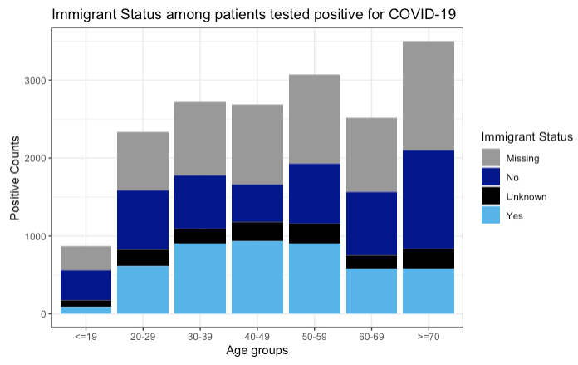
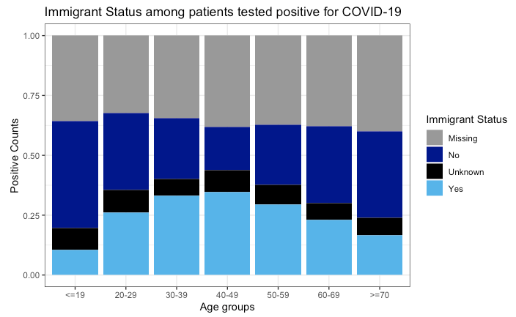
Immigrant Status Among Patients Tested Positive for COVID-19
Notes:
We see the graph of positive counts on the left and percentages on the right
Looking at age group of 40-49, a higher percentage of those tested positive are immigrants
9.4% non-immigrants to 20.3% immigrants in that category!
About 1/3 of the data is missing though --- why is it missing??? Are they more likely to be immigrants or not immigrants???

Slide 15
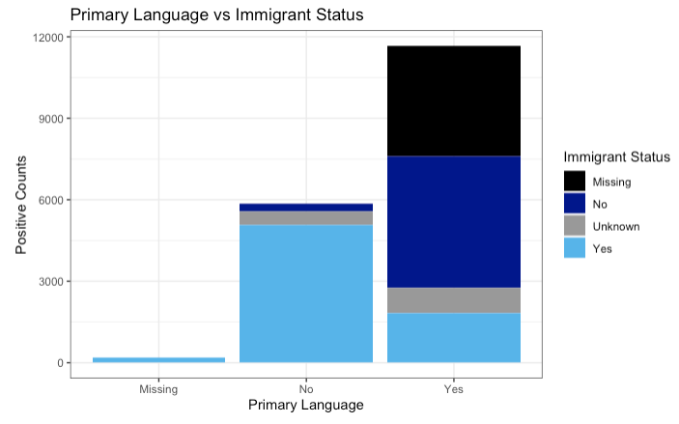
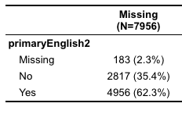
How do we fill in the missing data?
Primary Language?
If “no”, then they are more likely to be an immigrant
Notes:
Look at the second bar → English was NOT their primary language → 94.6% of them were immigrants!
Look at the third bar… :(
41.8% of those who wrote that English was their primary language are not immigrants
15% of those who wrote that English was their primary language are immigrants, might have moved to the US when they were very young
35% of those who wrote that English was their primary language have missing immigrant data :(
Looks like language can be used as an another indicator of immigrant status

Slide 16
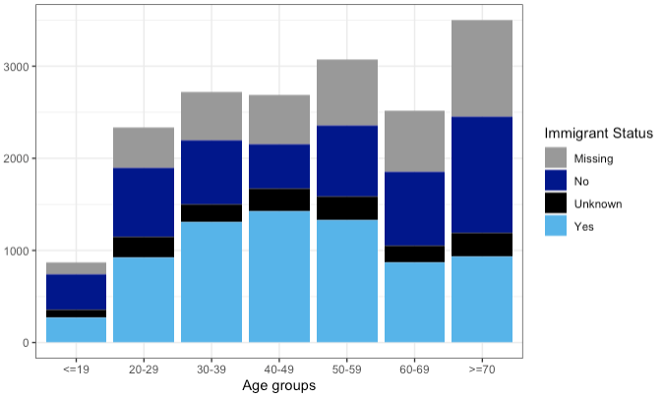
Immigrant Status Among Patients Tested Positive for COVID-19
Before
After
Notes:
Paints the same picture, but with less missing data!
Still a significant amt of the data is missing tho

Slide 17

Combing through the Patient Record
* Download all the patient notes by MRN
* Search for “immigrant” related keywords
* Match with the missing patients and seeing if any new ones come up
Unfortunately…no new data from this
Notes:
Another approach to filling in the data
Example of Reusing other datasets that were already there
One of the squiggly paths → did not result in any new information

Slide 18
Next steps in analysis
Positive Counts
Fill in Missing data?
Death
counts
Notes:
So far, just looking at people who’ve tested positive. Focused on filling in the missing data…
What about their death counts???

Slide 19
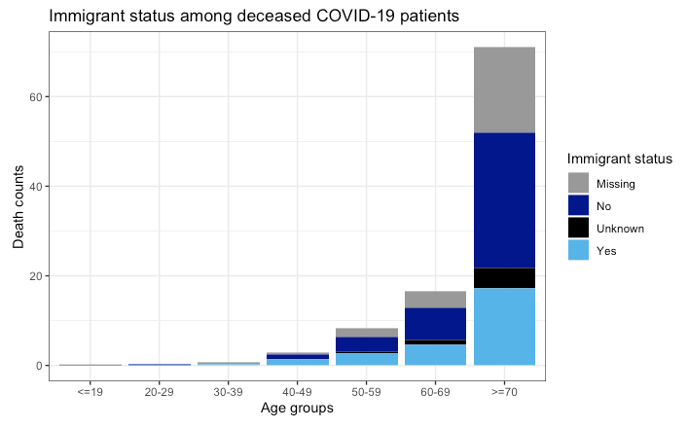
Life Status Among COVID-19 positive patients
Notes:
Among the immigrant statuses, oldest age ranges experience the most deaths.
Squished graphs, but even when I do the percentages, it remains similar
Okay, what if we look among the deceased patients, grouping by age and seeing their immigrant status?
Consistent with our knowledge of the mortality rates of different age groups for COVID
Nothing new, but also I processed in the data myself. Like doing a lab in class and seeing that yes your own results match up with the expected values

Slide 20
Factors to focus on
Immigrant
Status
Time
Age
Race
Ethnicity
Notes:
Again, rethinking the core factors that I wanted to research.
TIME FOR RACE AND ETHNICITY

Slide 21
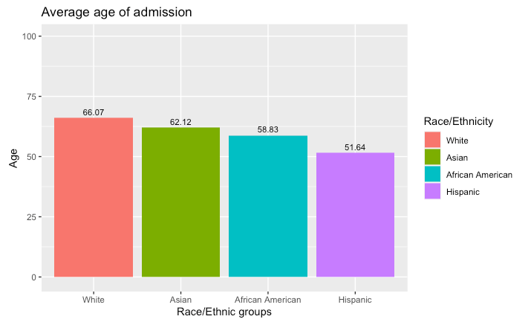
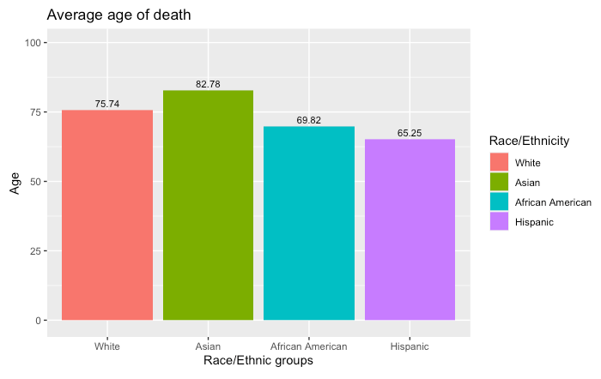
Race and Ethnicity on COVID-19 Positive Patients
Notes:
Racial/ethnic disparities
Excluded the missing and other populations
African American + Hispanic populations have a lower average age of admission and death
Consistent with the studies out there that focus on ethnicity in COVID patients
Most recent analysis I’ve done…but again, I’ve just focused on the MGH dataset.

Slide 22
Onwards
What’s the story?
Beyond MA → bigger picture
Lots of datasets out there!
Go and wrangle the data
Notes:
Beyond this little project… there’s just so much information out there about COVID-19
Living in a time where we have easy access to this information
Learn a bit more – learn stats and programming --- that is the future!! In a lot of professions – very applicable

Slide 23
The World at Large
Boston, MA
https://covidactnow.org/?s=870170
https://ourworldindata.org/coronavirus
Notes:
My data just focused on MA data, but again, this is affecting the entire world.
Particularly I like those two websites – they have graphs you can adjust and play around with
Just getting excited about data science

Slide 24
THANKS!
Any questions?
aly2@mgh.harvard.edu
amy.ly@tufts.edu
Notes:
That wraps up my presentation.
Thanks for listening
I will take any questions --- this is a recording tho :(

